Slide 1

Development of Stadium Management System
Prepared By Bit Rebels
Md. Faruk Hossain Id.16303013
Bodhrunnaher Sumi Id.16303031
Farhad Hossain Id.16303038
Taufiqur Rahman Id.16303039
Moumita Das Id. 16303038

Slide 2
Presentation Outline
Mission
Objective of the System
Process Model
Feasibility Study
UCD,DFD,ERD
Risk Engineering
Interface of Stadium Management Stadium
Conclusion & Future Work
Project demo

Slide 3
Mission
The mission of the project is to create a fully digital, faster, error free and easy to manage Stadium.
This project is created to improve Stadium management system.
This project will help to resolve error, speeding up process, save money and effort of Stadium management system.

Slide 4
Objective of This System
Online and digital stadium management system.
View Insert and manage audience.
Online and digital ticket.
View and manage of audience information.
Available functionality for performing various tasks.

Slide 5
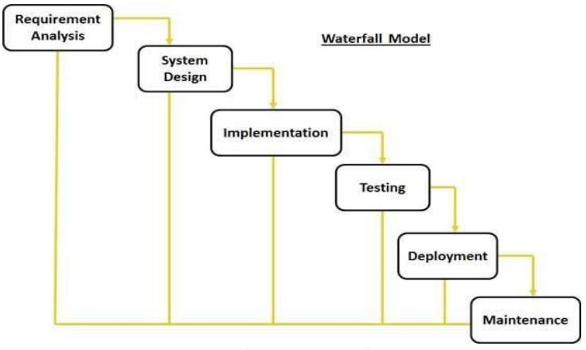
Process model

Slide 6
Feasibility Study
Economic Feasibility.
Technical Feasibility.
Operational Feasibility.

Slide 7
Risk Engineering
Project risks
Technical risks
Business risks

Slide 8
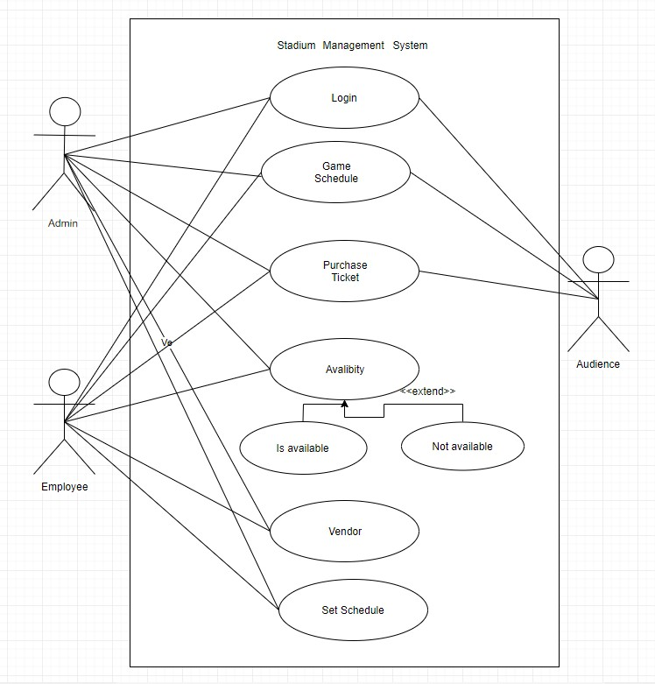
Use Case Diagram

Slide 9
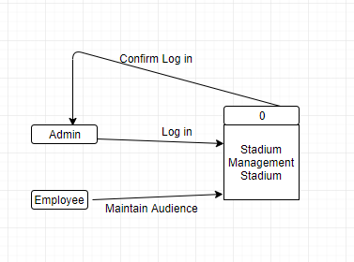
Data Flow Diagram

Slide 10
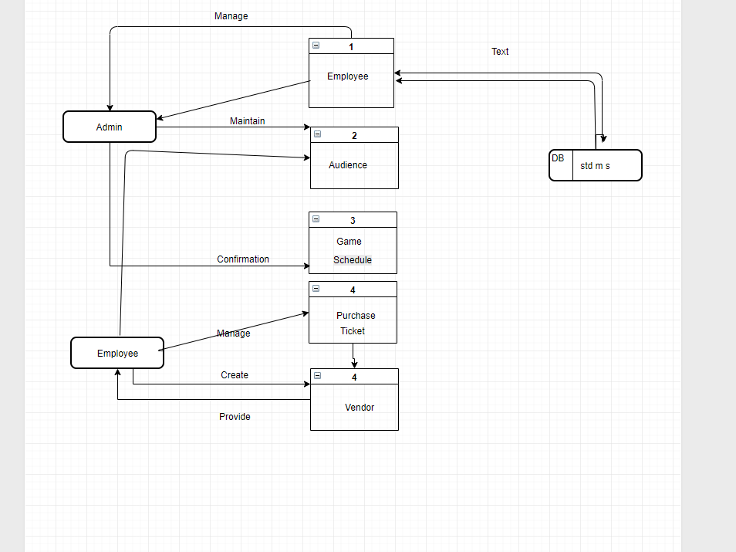
Data Flow Diagram

Slide 11
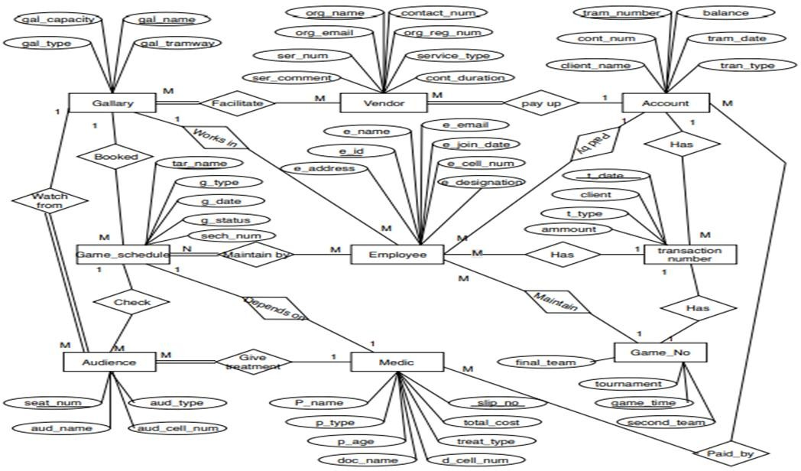
Entity Relationship Diagram

Slide 12
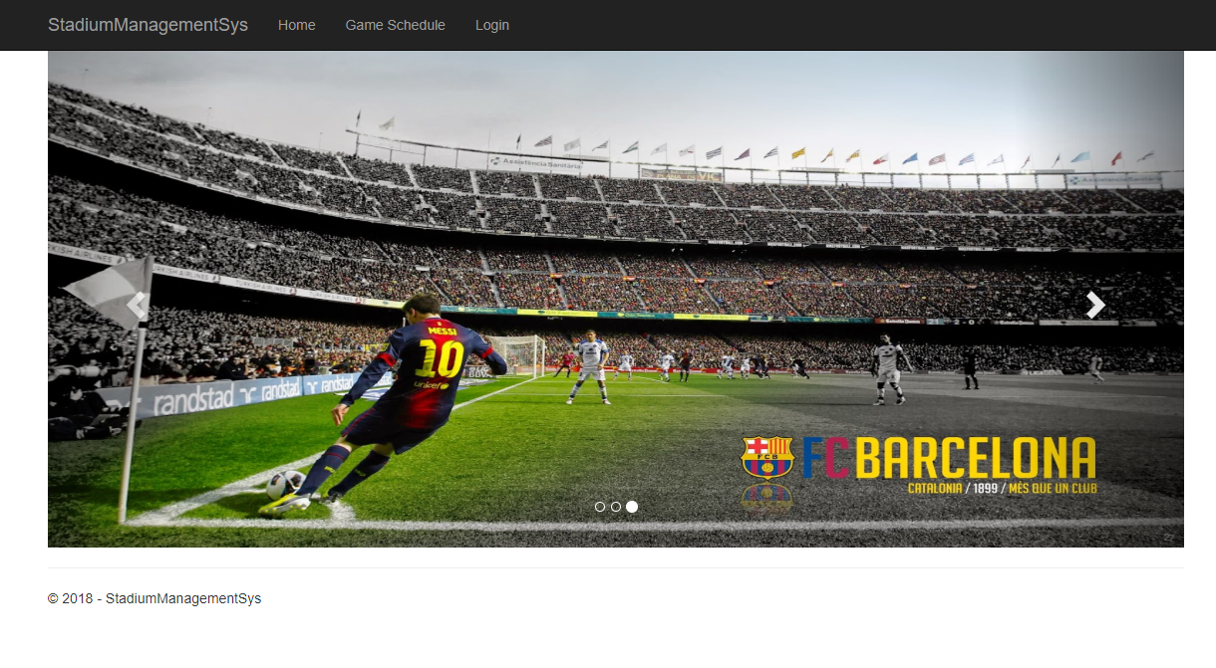
Interface of Stadium Management Stadium

Slide 13
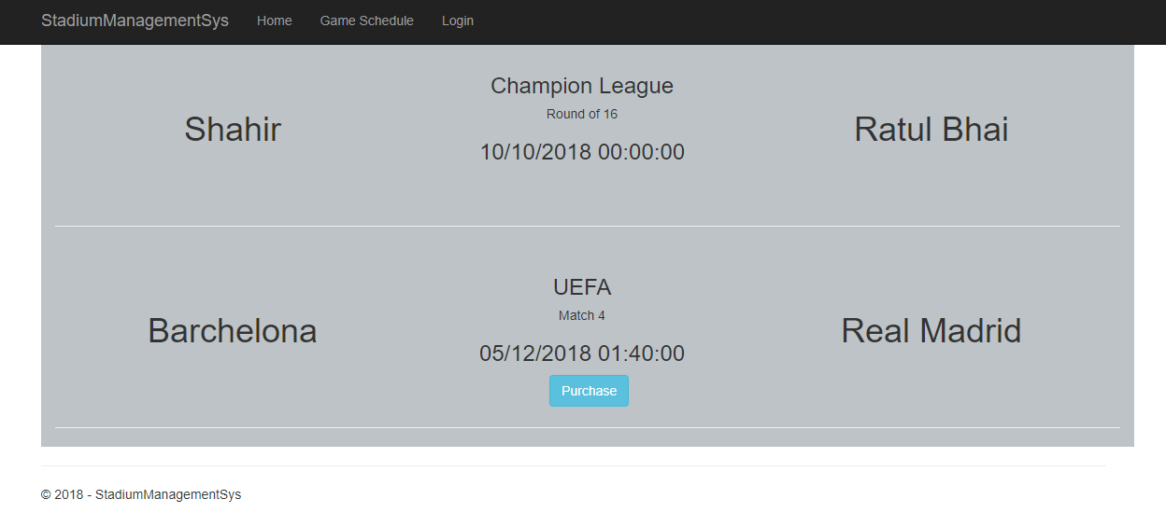
Interface of Stadium Management Stadium

Slide 14
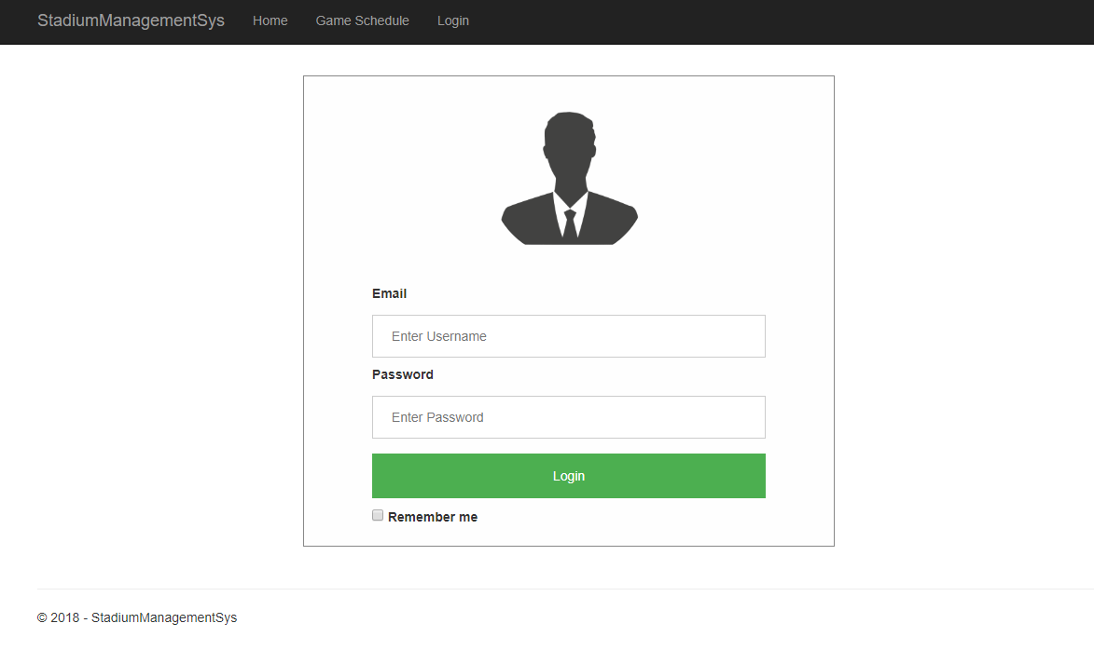
Interface of Stadium Management Stadium

Slide 15
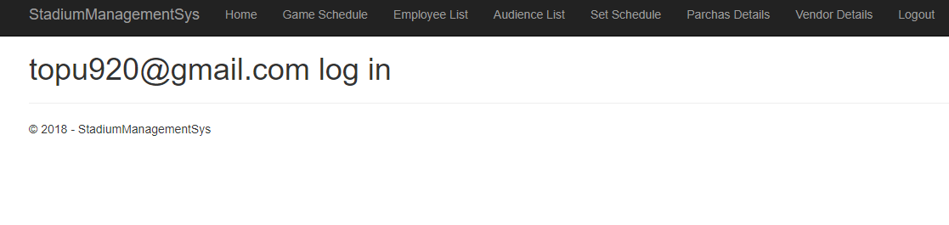
Interface of Stadium Management Stadium

Slide 16
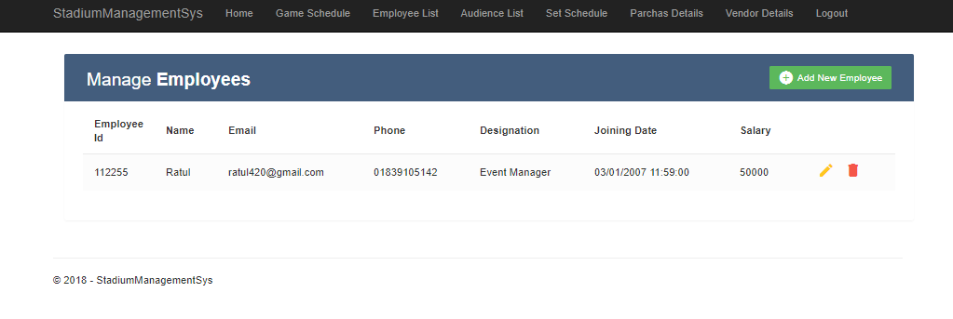
Interface of Stadium Management Stadium

Slide 17
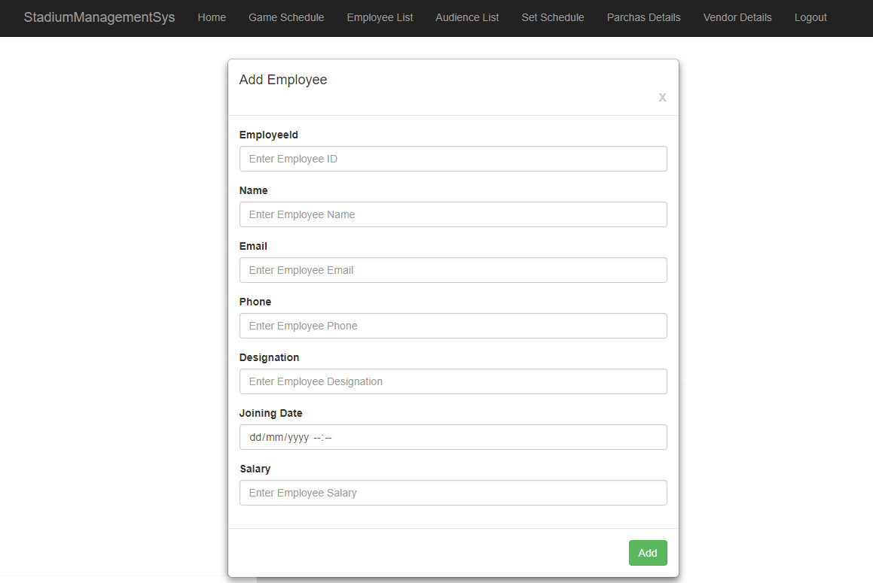
Interface of Stadium Management Stadium

Slide 18
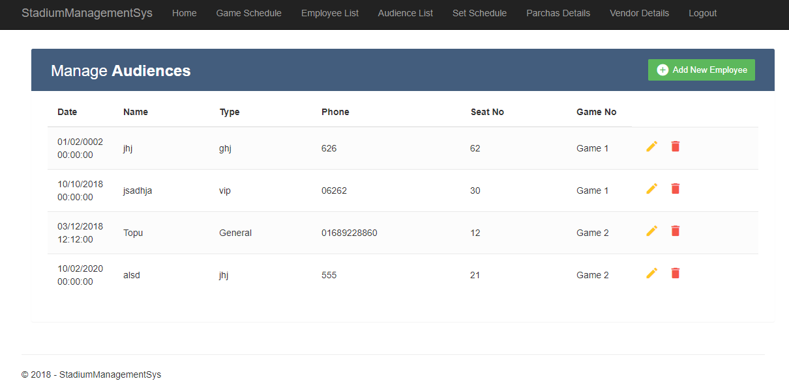
Interface of Stadium Management Stadium

Slide 19
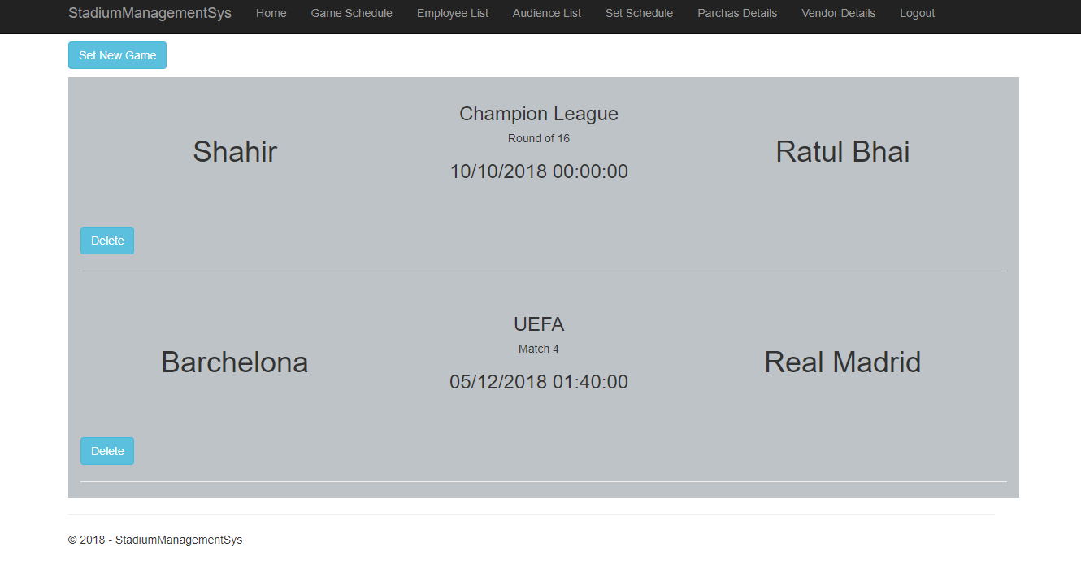
Interface of Stadium Management Stadium

Slide 20
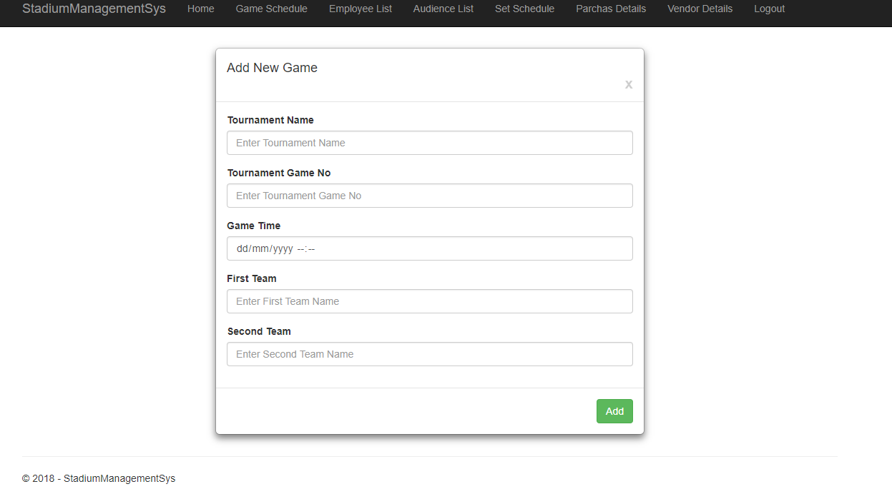
Interface of Stadium Management Stadium

Slide 21
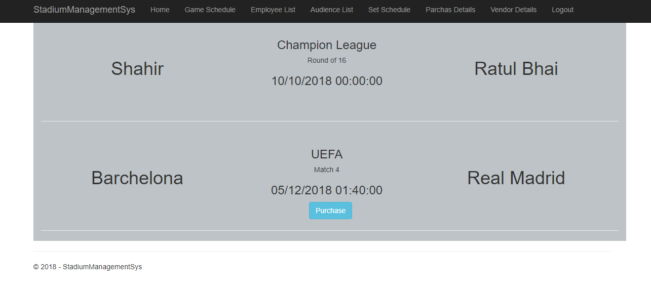
Interface of Stadium Management Stadium

Slide 22
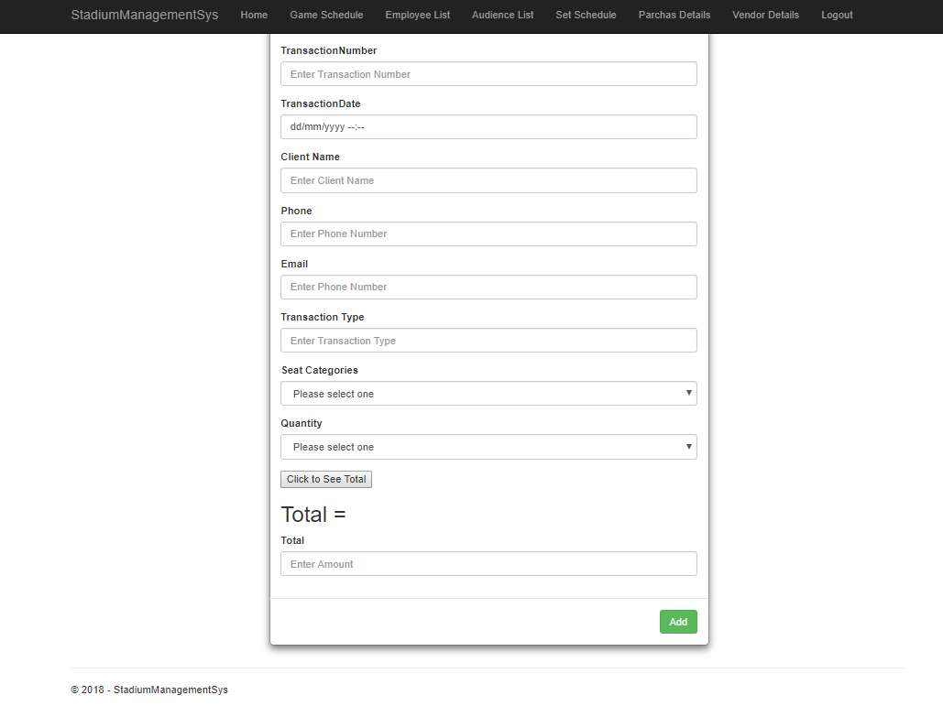
Interface of Stadium Management Stadium

Slide 23
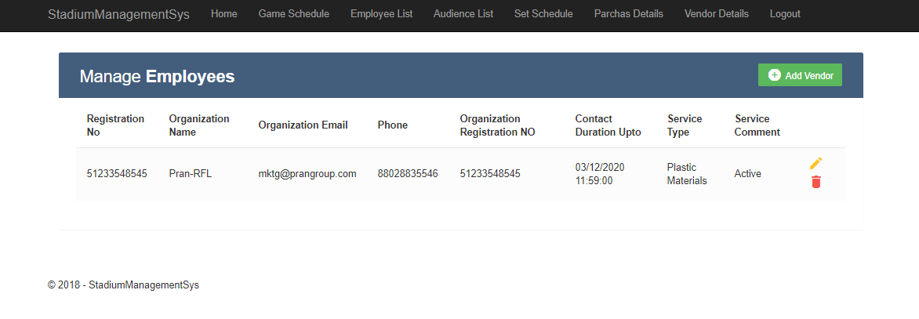
Interface of Stadium Management Stadium

Slide 24
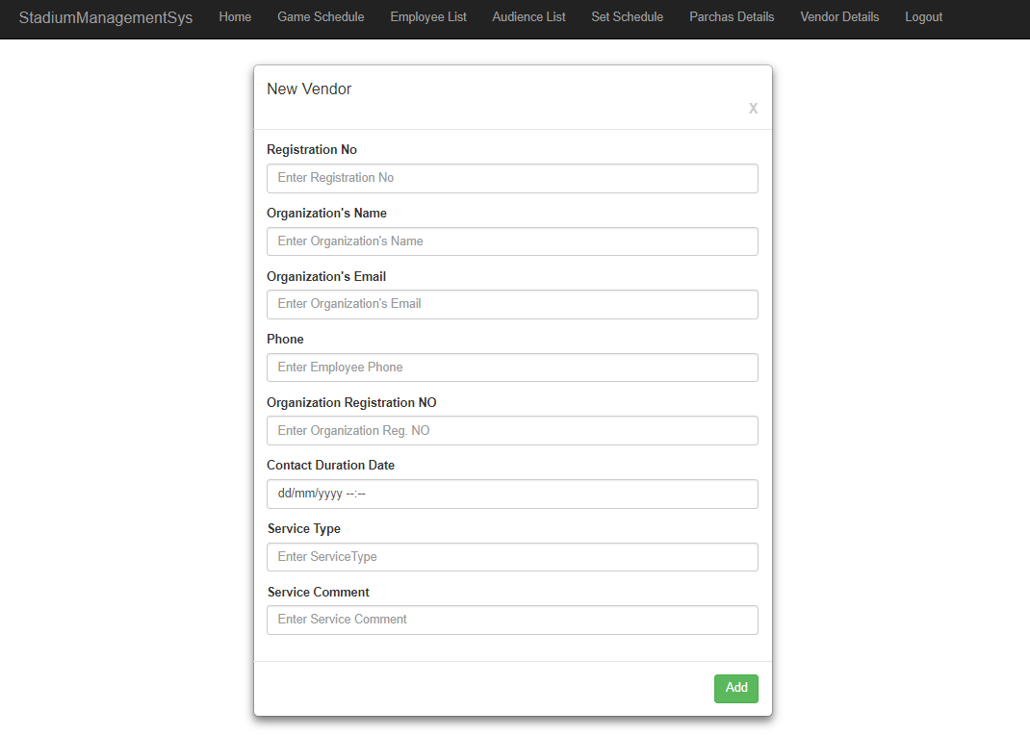
Interface of Stadium Management Stadium

Slide 25
Future Work
Feedback and Ticket send through e-mail
Score live update

Slide 26
Conclusion
The Stadium management system can keep all the information about stadium and matches. Viewer can get all the information about the matches they want to watch, they purchase the ticket and employees can maintain it.

Slide 27
Thank you!!!

